Slide 1
Biological Patterns

Slide 2
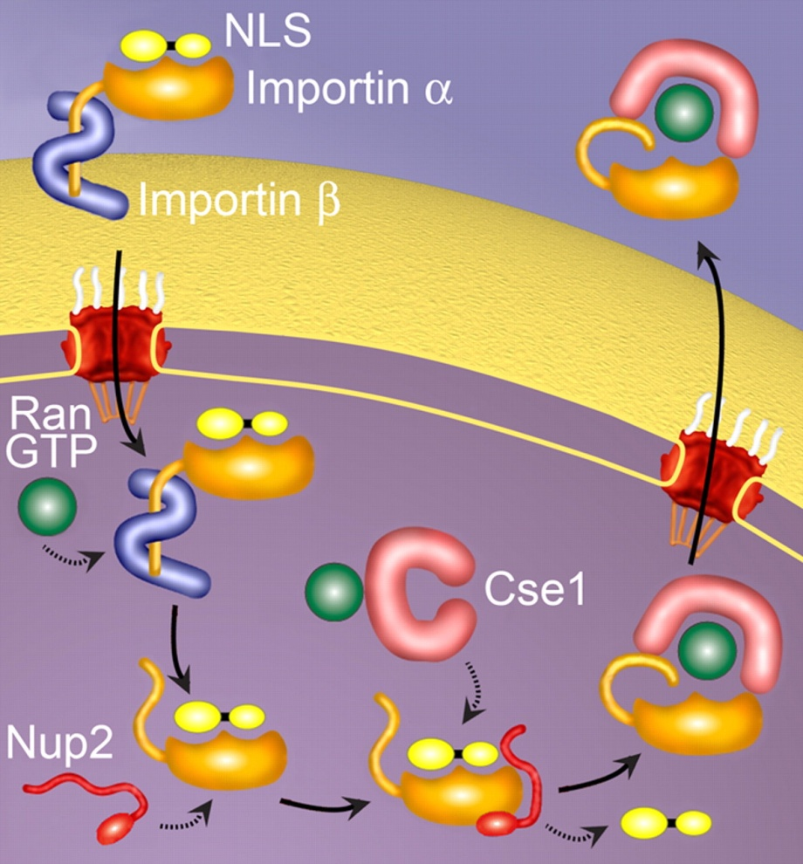
Patterns in Biology
Many biological processes make use of similar recognition signals embedded in DNA or protein sequences
One example is a Nuclear Localization Signal (NLS) in eukaryotic proteins which flags molecules for transport from the cytoplasm to the nucleus
Almost 45% of Yeast proteins have an amino acid sequence consisting of a classic NLS pattern that predisposes them for transportation mechanisms
Lange, A. et al (2007) J. Biol. Chem, 282, pp 5101-5105

Slide 3
Pattern Complexity
Patterns can be simple to describe
UAUUAUUACUAACAAGGAA
UCUUUUUACUAACAAUUUA
UUCCCUUACUAACAAAAAU
AAAUUGUACUAACAAACUU
GUCCUUUACUAACUUUAUU
AUUAAAUACUAACAUUUUG
UAUAUUUACUAACUUCUAU
Yeast branch points for
intron splicing are highly
conserved
UACUAAC
They can also be complex!
KRKNKKDLSTNQRALRR
KRKTKKDISNNQRSLRR
KRQHDNGNNHENSQKKR
KKLTKKQLKAQQFRKSK
KRHSQNDHSHSGRNKRR
KKWCDEYFYITHRKETR
KKNQEKSDQNETSKKRK
RKKLQDAREYKIGKERK
RKRDSENEEESEGTKKR
KRPHDDDGSSEKKKKKK
Yeast bipartite NLS signals have some flexibility in their sequence composition
[KR]-[KR]-x(8,10)-[[KR](3),x(2)]

Slide 4
Describing a Pattern
PROSITE is a protein pattern database that allows for the description and identification of specific amino acid profiles
Patterns are defined as regular expressions in the following manner:
Amino acids used when known
Positions are separated by ‘-’
‘x’ is a wildcard character
[] indicates ambiguity [one of]
{} indicates negation {not one of}
() indicates range of occurrences (min,max)
< or> indicates N or C terminus of protein, respectively
Examples:
[AC]-x-V-x(4)-{ED}.
This pattern is translated as: [Ala or Cys]-any-Val-any-any-any-any-{any but Glu or Asp}
<A-x-[ST](2)-x(0,1)-V.
This pattern, which must be in the N-terminal of the sequence ('<'), is translated as: Ala-any-[Ser or Thr]-[Ser or Thr]-(any or none)-Val
http://prosite.expasy.org/

Slide 5
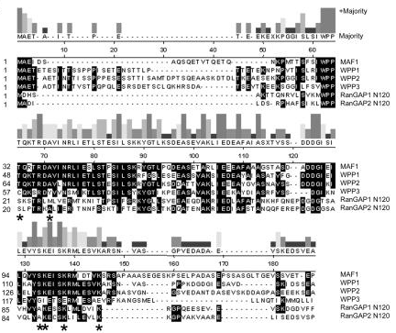
Defining a Pattern
Patterns are typically derived from multiple sequence alignments
There is a tradeoff, however, when defining patterns in terms of sensitivity (too strict) and specificity (too lax)
“W-P-P” would identify all of these domains but would also pick up many false positives
“W-P-P-[TCS]-[QKL]-[RKSP]-[TS]-R-[DLK]-[AYM]-[VL]-[ILV]-[NE]-[RS]-etc” would also identify all of these domains but would be unlikely to identify any other protein containing this domain
“W-P-P-x(3)-[TS]-R-x(6)-[SR]-x(5)-[TS](2)-x-[ST]-I-x(5)-G-x(6)-A-[KR]-x-I-E-etc” would allow ambiguity at some sites while still requiring specific residues and spacing
Patel, S. et al (2004) Plant Cell, 16(12), pp 3260-3273

Slide 6
Limitations of Patterns
AGAAAACGACAAGGAAAGGTATTTG
ATCTGAAGGGGGATTTTGGAGAATG
GTGAAAAATTGGAGGGAAACTCATG
CAATTAGAGAGGAGAATTCGATATG
AAAGCGAAGGACTCGGCGAGTAATG
ACATACCCTGCAAGGATGATTAATG
AAAAGGAAGGGAGGTCTATCTCATG
TTAAATATGGTGGTGGAAACAGATG
TTTCGAAAGGATTGTTTATAAAATG
TAAATAGAAGGAGGCGCACAAAATG
ACCGTTATGGAGGGATACATAAATG
TAACTGAATTTAAAGGAGGTTCATG CGTTTAAAATGCATAATAAGGAGTG
TGGAAAACAGGGAGAGATCATAATG
TGCAAACTAACGGGGGGATAATATG
AAAAGAAAAAGGAGATGGGAGTATG
Patterns are very useful, but are qualitative in nature and thus are limited in their ability capture more subtle signals
e.g. is alanine, is not lysine
Many motifs are flexible and can be represented by multiple compositions while still consisting of a primary sequence.
Shine-Delgarno ribosomal binding site sequences in B. subtilis
consensus: AGGAGG
Frishman, D et al (1998) Nuc. Acids Res., 26(12), pp 2941-2947

Slide 7
Position Specific Scoring Matrix (PSSM)
A PSSM is a quantitative approach that not only specifies which specific nucleotides/residues may be present at each position but also derives scores based on their relative frequencies
PSSMs thus would have a column for each position in the motif and either 4 rows (nucleotide) or 20 rows (amino acid), with each cell consisting of a score or weight for each element
A PSSM can also referred to as a Positional Weight Matrix (PWM)

Slide 8
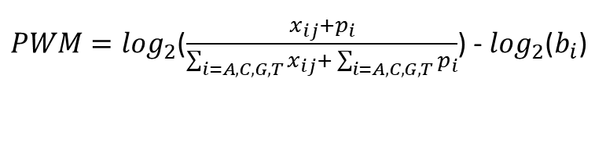
Deriving a PSSM
Alignment Matrix
 | 1 | 2 | 3 | 4 | 5 | 6
A | 11 | 0 | 1 | 13 | 1 | 4
C | 0 | 1 | 0 | 0 | 1 | 0
T | 3 | 1 | 0 | 1 | 2 | 2
G | 2 | 14 | 15 | 2 | 12 | 10
Consensus | A | G | G | A | G | G
AGAAAACGACAAGGAAAGGTATTTG
ATCTGAAGGGGGATTTTGGAGAATG
GTGAAAAATTGGAGGGAAACTCATG
CAATTAGAGAGGAGAATTCGATATG
AAAGCGAAGGACTCGGCGAGTAATG
ACATACCCTGCAAGGATGATTAATG
AAAAGGAAGGGAGGTCTATCTCATG
TTAAATATGGTGGTGGAAACAGATG
TTTCGAAAGGATTGTTTATAAAATG
TAAATAGAAGGAGGCGCACAAAATG
ACCGTTATGGAGGGATACATAAATG
TAACTGAATTTAAAGGAGGTTCATG CGTTTAAAATGCATAATAAGGAGTG
TGGAAAACAGGGAGAGATCATAATG
TGCAAACTAACGGGGGGATAATATG
AAAAGAAAAAGGAGATGGGAGTATG
$PWM=\log_{2}$($\frac{x_{ij}+p_{i}}{\sum_{i=A,C,G,T}{x_{ij}+ \sum_{i=A,C,G,T}{p_{i}}}}$) - $\log_{2}$($b_{i}$)
x_{ij} is the number of times nucleotide i is observed at position j, p_{i} is the pseudocount or Laplace estimator, and b_{i} is the expected probability (a priori) of observing nucleotide i overall. Using a pseudocount of 0.25 and a uniform background probability of 0.25, we can thus derive:
Positional Weight Matrix
 | 1 | 2 | 3 | 4 | 5 | 6
A | 1.40 | -4.09 | -1.77 | 1.64 | -1.77 | 0.00
C | -4.09 | -1.77 | -4.09 | -4.90 | -1.77 | -4.09
T | -0.39 | -1.77 | -4.09 | -1.77 | -0.92 | -0.92
G | -0.92 | 1.75 | 1.84 | -0.92 | 1.53 | 1.27
Hertz GZ and Stormo GD (1999) Bioinformatics, 15, pp. 563-577

Slide 9
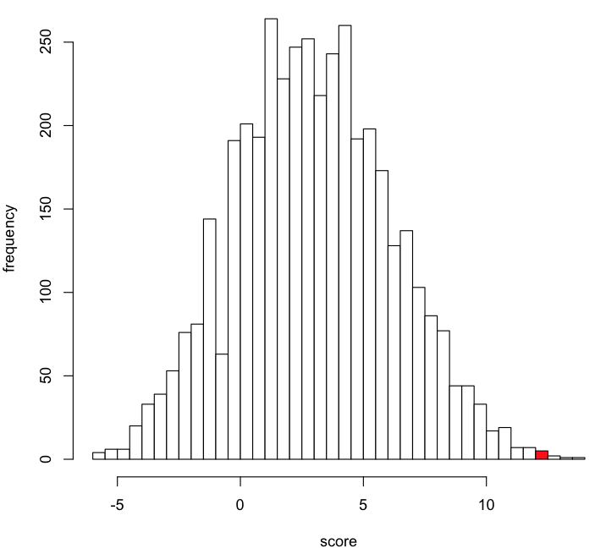
Scoring a sequence against a PSSM
Weight Matrix
 | 1 | 2 | 3 | 4 | 5 | 6
A | 1.40 | -4.09 | -1.77 | 1.64 | -1.77 | 0.00
C | -4.09 | -1.77 | -4.09 | -4.90 | -1.77 | -4.09
T | -0.39 | -1.77 | -4.09 | -1.77 | -0.92 | -0.92
G | -0.92 | 1.75 | 1.84 | -0.92 | 1.53 | 1.27
 | G | G | G | A | G | G
Test Sequence
GGGAGG
Score (sum of weights)
7.11
Is this significant?
Distribution of scores for all possible permutations of A,C,T,G for a string of length 6
GGGAGG

Slide 10
Information Content (IC)
It is often useful to consider PSSMs in the context of information content, which is a measure of how divergent it is from the expected distribution
Example:
Promoter regions are typically GC-rich
Therefore, an AT-rich motif in a promoter region contains much more information
The Kullback-Leibler divergence, also referred to as relative entropy, is one way to measure this: where p_{i.j} is the probability of observing character i at position j, and p_{i} is the overall probability at any position

Slide 11
Pseudocounts
There are often cases where there are 0 observations for a particular symbol, leading to complications when attempting to use those values in equations
One solution is to simply add 1 to each observation (Laplace rule of succession)
Another approach is to take the square root of the total number of input sequences, adjusted for background probabilities
 | 1 | 2 | 3 | 4 | 5 | 6
A | 11 | 0 | 1 | 13 | 1 | 4
C | 0 | 1 | 0 | 0 | 1 | 0
T | 3 | 1 | 0 | 1 | 2 | 2
G | 2 | 14 | 15 | 2 | 12 | 10
D_{KL} = 6.47
 | 1 | 2 | 3 | 4 | 5 | 6
A | 12 | 1 | 2 | 14 | 2 | 5
C | 1 | 2 | 1 | 1 | 2 | 1
T | 4 | 2 | 1 | 2 | 3 | 3
G | 3 | 15 | 16 | 3 | 13 | 11
D_{KL} = 3.85

Slide 12
Relative Entropy
Alignment Matrix
Probability Matrix
 | 1 | 2 | 3 | 4 | 5 | 6
A | 11 | 0 | 1 | 13 | 1 | 4
C | 0 | 1 | 0 | 0 | 1 | 0
T | 3 | 1 | 0 | 1 | 2 | 2
G | 2 | 14 | 15 | 2 | 12 | 10
 | 1 | 2 | 3 | 4 | 5 | 6
A | 0.69 | 0 | 0.06 | 0.81 | 0.06 | 0.25
C | 0 | 0.06 | 0 | 0 | 0.06 | 0
T | 0.19 | 0.06 | 0 | 0.06 | 0.13 | 0.13
G | 0.13 | 0.88 | 0.94 | 0.13 | 0.75 | 0.63
Entropy Matrix
 | 1 | 2 | 3 | 4 | 5 | 6
A | 1 | 0 | -0.13 | 1.38 | -0.13 | 0
C | 0 | -0.12 | 0 | 0 | -0.13 | 0
T | -0.08 | -0.12 | 0 | -0.13 | -0.13 | -0.13
G | -0.13 | 1.61 | 1.79 | -0.13 | 1.19 | 0.83
Σ | 0.80 | 1.36 | 1.66 | 1.13 | 0.81 | 0.70
Σ
6.47

Slide 13
Identifying Matches to PSSMs
A typical approach to finding a match to a PSSM is to score all possible subsequences and choose the maximum above the chosen threshold
A sliding window approach is easy to implement:
2.12
TAACGGGGGGATAATATGTTTGCAAAC
3.95
TAACGGGGGGATAATATGTTTGCAAAC
9.67
TAACGGGGGGATAATATGTTTGCAAAC
8.29
TAACGGGGGGATAATATGTTTGCAAAC
10.49
TAACGGGGGGATAATATGTTTGCAAAC
9.61
TAACGGGGGGATAATATGTTTGCAAAC
6.70
TAACGGGGGGATAATATGTTTGCAAAC

Slide 14
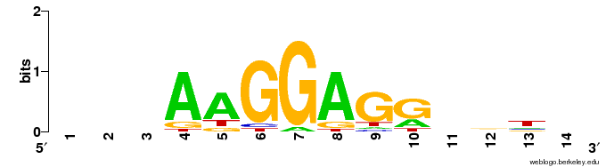
Sequence Logos
Uses information content to depict motif characteristics in a visual manner
Schneider, TD and Stephens, RM (1990) Nucleic Acids Res., 18, pp. 6097-6100

Slide 15
Extra Slides (informational only)

Slide 16
Searching for Conserved Domains
In some cases, motifs are too subtle for standard multiple sequence alignments to identify and describe
This is particularly true for proteins which may contain conserved subsequences but which are otherwise too divergent to identify strictly through pairwise alignments (BLAST)

Slide 17
PSI-BLAST
Position-Specific Iterative (PSI) BLAST begins with a standard BLASTp alignment, but then generates a multiple sequence alignment from the highest scoring pairwise hits and builds a PSSM from that alignment.
This PSSM is then used in place of the normal substitution matrix and the database is searched again
This process is repeated, each time with an updated PSSM, until a particular user-designated threshold is met

Slide 18
PSI-BLAST – Example
Uncharacterized protein:
MRLIMMKVSAYDLNKIAEKLNLSIKDLNKAFSRKILREDEYKEIKTLLFKKEFKGIEKGTVIFLN
Initial BLASTp (iteration 1)
60725 1 MRLIMMKVS AYDLNKIAEKLNLSIKDLNKAFSRKILREDEYKEIKTLLFKKEFKGIEKGTVIFLN------------ 65
NP_247388 1 MRLIMMKVS AYDLNKIAEKLNLSIKDLNKAFSRKILREDEYKEIKTLLFKKEFKGIEKGTVIFLNDNLDVVRGYPKT 77
YP_003459090 1 ----MMKVL TYDLNKIAEKLNLSIKDLNKAFNKKILREDEYKETKTLLFKKEFKGVEKGTVIFLNDNLDVVRGYPKT 73
YP_003128614 1 -----MQVS AYALDKIAEKLNLSIKDLNKAFKKKILREDEYKEQKYLLFKKGFRGIEKGTVIFLNENLDVVRGYPKT 72
YP_003247161 1 -----MNVL SYDLNKIAEKLNISLKDLNKAFKKRILRENEYKDVKTLIFKKDFRGIEKGTVIFLNKNLDVVRGYPKT 72
YP_003615688 1 ----MAEVK AYSLENIAKKLNLEVRDISRAVKRKILREYEYKDTKILLFKKEFKHIEKGTVVFLNDNLDVVRGYPKT 73
YP_001324852 1 MDIDIDMLK[7]LNILPKISERLNITESDLKNAINRKIIAHDTYKNQKYILFKKKYRHIERGTILFLNENLDYIMGYPKI 84
YP_001323873 1 MNGLFSK--[6]KEIVQKISKRLNLNPNDLEKGFERKIITKYEYNDKKYLCFKKKLRHIERGTIVFLNDNFDYFCGYPKI 81
YP_004484151 1 MEIDYAL-- ------IAERLKLREEDIRRGFKRGIIIREEYKGVPMIAFRKKIKHIERGTALFLNENLDYIMGYPKI 69
YP_001330588 1 MDKMYLS--[6]EEFIVNASKRLNIDEDTLKNGFSRKLITKYEYNEKKYLCFKKKLKHIERGTILFLNNNLDFIQGYPKI 81
ZP_09707562 1 MEMNYSL-- ------IAERLKLRDDDIKRGFKRGIIGRIEYKGIPMITFRKKIKHVERGTTLFLNEDLDYVAGYPKI 69

Slide 19
PSI-BLAST – Example
PSI-BLAST (iteration 2)
60725 1 MRLIMMK---VSAYD LNKIAEKLNLSIKDLNKAFSRKILREDEYKEIKTLLFKKEFKGIEKGTVIFLN--------- 65
NP_247388 1 MRLIMMK---VSAYD LNKIAEKLNLSIKDLNKAFSRKILREDEYKEIKTLLFKKEFKGIEKGTVIFLNDNLDVVRGY 74
YP_003459090 1 ----MMK---VLTYD LNKIAEKLNLSIKDLNKAFNKKILREDEYKETKTLLFKKEFKGVEKGTVIFLNDNLDVVRGY 70
YP_003128614 1 -----MQ---VSAYA LDKIAEKLNLSIKDLNKAFKKKILREDEYKEQKYLLFKKGFRGIEKGTVIFLNENLDVVRGY 69
YP_003247161 1 -----MN---VLSYD LNKIAEKLNISLKDLNKAFKKRILRENEYKDVKTLIFKKDFRGIEKGTVIFLNKNLDVVRGY 69
YP_003615688 1 ----MAE---VKAYS LENIAKKLNLEVRDISRAVKRKILREYEYKDTKILLFKKEFKHIEKGTVVFLNDNLDVVRGY 70
YP_001323873 1 MNGLFSK-tnNKEFK[2]VQKISKRLNLNPNDLEKGFERKIITKYEYNDKKYLCFKKKLRHIERGTIVFLNDNFDYFCGY 78
YP_001330588 1 MDKMYLS-ddILNFE[2]IVNASKRLNIDEDTLKNGFSRKLITKYEYNEKKYLCFKKKLKHIERGTILFLNNNLDFIQGY 78
YP_004484151 1 MEIDYAL-------- ---IAERLKLREEDIRRGFKRGIIIREEYKGVPMIAFRKKIKHIERGTALFLNENLDYIMGY 66
YP_001097774 1 MDKMYLS-edIPNFE[2]IINASKRLNIDEDTLENGFKRKLITKYEYNGKKYLCFKKKLKHIERGTILFLNDNLDFIQGY 78
YP_001548583 1 MDKMYLL-kdISNFE[2]ILNASKRLNIDEDTLKNGFKRKLITKYEYNGKKYLCFKKKLKHIERGTILFLNDNLDFIMGY 78
YP_004742018 1 MDKTYFS-edILNFE[2]IVDASKKLNIDEDTLKNGFKRKLITKYEYNGRKYLCFKKKLKHIERGTILFLNDNLDFIIGY 78
NP_987496 1 MDKTYFS-edILNFE[2]IIDASKKLNIDEDTLKNGFKRKLITKYEYNGRKYLCFKKKLKHIERGTILFLNDNLDFIIGY 78
YP_001324852 1 MDIDIDMlkrNKNQR[4]LPKISERLNITESDLKNAINRKIIAHDTYKNQKYILFKKKYRHIERGTILFLNENLDYIMGY 81
ZP_09707562 1 MEMNYSL-------- ---IAERLKLRDDDIKRGFKRGIIGRIEYKGIPMITFRKKIKHVERGTTLFLNEDLDYVAGY 66
YP_004576320 1 MDIDI---------- -LKVSERLKLDEVDIKKAFERKIISFDMYHNKKYLLFKKKLRHIERGTVLFLNNNMDIVMGY 66

Slide 20
Iteration 1 – BLOSUM62
A R N D C Q E G H I L K M F P S T W Y V
-1 -1 -2 -3 -1 0 -2 -3 -2 1 2 -1 5 0 -2 -1 -1 -1 -1 -1
-1 5 0 -2 -3 1 0 -2 0 -3 2 -1 -3 -2 -1 -1 -3 -2 -3 -1
-1 -2 -3 -4 -1 -2 -3 -4 -3 2 4 -2 2 0 -3 -2 -1 -2 -1 1
-1 -3 -3 -3 -1 -3 -3 -4 -3 4 2 -3 1 0 -3 -2 -1 -3 -1 3
-1 -1 -2 -3 -1 0 -2 -3 -2 1 2 -1 5 0 -2 -1 -1 -1 -1 -1
-1 -1 -2 -3 -1 0 -2 -3 -2 1 2 -1 5 0 -2 -1 -1 -1 -1 -1
-1 2 0 -1 -3 1 1 -2 -1 -3 -2 5 -1 -3 -1 0 -1 -3 -2 -2
0 -3 -3 -3 -1 -2 -2 -3 -3 3 1 -2 1 -1 -2 -2 0 -3 -1 4
1 -1 1 0 -1 0 0 0 -1 -2 -2 0 -1 -2 -1 4 1 -3 -2 -2
4 -1 -2 -2 0 -1 -1 0 -2 -1 -1 -1 -1 -2 -1 1 0 -3 -2 0
-2 -2 -2 -3 -2 -1 -2 -3 2 -1 -1 -2 -1 3 -3 -2 -2 2 7 -1
-2 -2 1 6 -3 0 2 -1 -1 -3 -4 -1 -3 -3 -1 0 -1 -4 -3 -3
-1 -2 -3 -4 -1 -2 -3 -4 -3 2 4 -2 2 0 -3 -2 -1 -2 -1 1
-2 0 6 1 -3 0 0 0 1 -3 -3 0 -2 -3 -2 1 0 -4 -2 -3
-1 2 0 -1 -3 1 1 -2 -1 -3 -2 5 -1 -3 -1 0 -1 -3 -2 -2
-1 -3 -3 -3 -1 -3 -3 -4 -3 4 2 -3 1 0 -3 -2 -1 -3 -1 3
4 -1 -2 -2 0 -1 -1 0 -2 -1 -1 -1 -1 -2 -1 1 0 -3 -2 0
-1 0 0 2 -4 2 5 -2 0 -3 -3 1 -2 -3 -1 0 -1 -3 -2 -2
-1 2 0 -1 -3 1 1 -2 -1 -3 -2 5 -1 -3 -1 0 -1 -3 -2 -2
-1 -2 -3 -4 -1 -2 -3 -4 -3 2 4 -2 2 0 -3 -2 -1 -2 -1 1
-2 0 6 1 -3 0 0 0 1 -3 -3 0 -2 -3 -2 1 0 -4 -2 -3
-1 -2 -3 -4 -1 -2 -3 -4 -3 2 4 -2 2 0 -3 -2 -1 -2 -1 1
1 -1 1 0 -1 0 0 0 -1 -2 -2 0 -1 -2 -1 4 1 -3 -2 -2
-1 -3 -3 -3 -1 -3 -3 -4 -3 4 2 -3 1 0 -3 -2 -1 -3 -1 3
-1 2 0 -1 -3 1 1 -2 -1 -3 -2 5 -1 -3 -1 0 -1 -3 -2 -2
-2 -2 1 6 -3 0 2 -1 -1 -3 -4 -1 -3 -3 -1 0 -1 -4 -3 -3
-1 -2 -3 -4 -1 -2 -3 -4 -3 2 4 -2 2 0 -3 -2 -1 -2 -1 1
-2 0 6 1 -3 0 0 0 1 -3 -3 0 -2 -3 -2 1 0 -4 -2 -3
-1 2 0 -1 -3 1 1 -2 -1 -3 -2 5 -1 -3 -1 0 -1 -3 -2 -2
4 -1 -2 -2 0 -1 -1 0 -2 -1 -1 -1 -1 -2 -1 1 0 -3 -2 0
-2 -3 -3 -3 -2 -3 -3 -3 -1 0 0 -3 0 6 -4 -2 -2 1 3 -1
1 -1 1 0 -1 0 0 0 -1 -2 -2 0 -1 -2 -1 4 1 -3 -2 -2
-1 2 0 -1 -3 1 1 -2 -1 -3 -2 5 -1 -3 -1 0 -1 -3 -2 -2
-1 -3 -3 -3 -1 -3 -3 -4 -3 4 2 -3 1 0 -3 -2 -1 -3 -1 3
Query Sequence
1
2
3
4
5
6
7
8
9
10
11
12
13
14
15
16
17
18
19
20
21
22
23
24
25
26
27
28
29
30
31
32
33
34
MRLIMMKVSAYDLNKIAEKLNLSIKDLNKAFSKI

Slide 21
Iteration 2 – PSI-BLAST PSSM
A R N D C Q E G H I L K M F P S T W Y V
-1 -1 -2 -3 -1 0 -2 -3 -2 1 2 -1 5 0 -3 -2 -1 -1 -1 1
-1 6 0 -2 -3 1 0 -2 0 -3 -2 2 -1 -3 -2 -1 -1 -3 -2 -3
-1 -2 -3 -4 -1 -2 -3 -4 -3 2 4 -2 2 0 -3 -2 -1 -2 -1 1
-1 -3 -3 -3 -1 -3 -3 -4 -3 4 2 -3 1 0 -3 -2 -1 -3 -1 3
-1 -2 -2 -3 -2 0 -2 -3 -2 1 2 -2 6 0 -3 -2 -1 -2 -1 2
-1 -2 -2 -3 -1 -1 -2 -2 -2 1 2 -1 5 -1 -2 -1 -1 -2 -1 2
-1 2 3 1 -3 3 3 -2 0 -3 -3 3 -2 -3 -1 0 -1 -3 -2 -3
0 -3 -3 -4 -1 -2 -3 -4 -3 3 1 -3 1 -1 -3 -2 0 -3 -1 1
0 0 -1 -1 -2 0 -1 -2 -2 0 2 2 0 -1 -2 2 0 -3 -2 2
3 -1 -1 -1 -1 -1 -1 0 -2 -2 -2 -1 -1 -2 -1 2 2 -3 -2 -2
-2 -2 -2 -3 -3 -2 -2 -3 2 -2 -1 -2 -1 3 -3 -2 -2 2 7 -1
1 -2 1 5 -3 0 1 -1 -1 -3 -3 -1 -3 -3 -1 1 0 -4 -3 -3
-2 -2 -3 -4 -2 -2 -3 -4 -2 1 4 -3 1 1 -3 -2 -1 -1 3 1
1 -1 3 2 -3 2 2 -1 0 -3 -3 0 -2 -3 3 0 -1 -3 -2 -3
-1 1 2 -1 -3 1 0 -2 -1 -2 0 5 -1 -2 -2 -1 -1 -3 -2 -2
-2 -4 -4 -3 -2 -3 -4 -4 -4 5 1 -3 1 0 -3 -3 -1 -3 -2 3
4 -1 -1 -1 -1 -1 -1 0 -2 -2 -2 -1 -1 -3 -1 3 1 -3 -2 -1
-1 1 0 1 -4 2 5 -2 -1 -3 -3 3 -2 -4 -1 0 -1 -3 -2 -3
-1 5 -1 -1 -4 1 0 -2 -1 -3 -3 4 -2 -3 -2 -1 -1 -3 -2 -2
-2 -3 -4 -4 -2 -3 -3 -4 -3 2 5 -3 2 0 -3 -3 -2 -2 -1 1
-2 0 6 1 -3 0 0 -1 0 -4 -4 2 -2 -4 -2 0 0 -4 -2 -3
-2 -3 -4 -4 -2 -3 -3 -4 -3 3 4 -3 2 0 -3 -3 -1 -2 -1 2
0 2 2 3 -2 0 1 -1 -1 -3 -3 0 -2 -3 -2 2 1 -3 -2 -2
-1 -1 -1 2 -3 0 3 -3 -1 1 0 -1 0 -2 1 -1 -1 -3 -2 1
-1 2 2 4 -3 1 2 -2 -1 -3 -3 3 -2 -4 -2 1 -1 -4 -3 -3
-2 -2 1 6 -3 -1 1 -2 -2 -3 -3 -1 -3 -4 -2 0 2 -4 -3 -3
-2 -3 -4 -4 -2 -3 -3 -4 -3 3 4 -3 2 0 -3 -3 -1 -2 -1 1
-1 2 3 0 -3 1 2 -1 0 -3 -3 3 -2 -3 -2 1 0 -4 -2 -3
-1 4 4 0 -3 1 0 -2 0 -3 -3 3 -2 -3 -2 0 -1 -4 -2 -3
3 -2 -1 -2 -2 -2 -2 5 -2 -3 -3 -1 -2 -3 -2 0 -1 -3 -3 -2
-2 -3 -4 -4 -2 -4 -4 -4 -2 1 0 -3 0 6 -4 -3 -2 0 3 -1
-1 1 2 0 -3 1 1 -1 -1 -3 -3 4 -2 -3 -1 1 0 -3 -2 -3
-2 6 0 -2 -4 1 0 -3 -1 -3 -3 3 -2 -3 -2 -1 -1 -3 -2 -3
-2 2 -4 -1 -2 1 0 2 -1 -3 -3 4 -2 -3 -2 0 -1 -3 -2 -2
Query Sequence
1
2
3
4
5
6
7
8
9
10
11
12
13
14
15
16
17
18
19
20
21
22
23
24
25
26
27
28
29
30
31
32
33
34
MRLIMMKVSAYDLNKIAEKLNLSIKDLNKAFSKI

Slide 22
Addressing Corruption
The largest source of error with PSI-BLAST is the inclusion of unrelated protein alignments which alter and eventually corrupt the derived PSSM
Selecting a more stringent threshold (E-value) for inclusion can mollify this, however it may also preclude the identification of real signals
Manual selection/de-selection of proteins to include in the next iteration will also help refine the future results

